Slide 1




PONMITRAN
A Smart Solution For Feed Management
FULL STACK PROJECT REVIEW
MICHAEL ROBIN. K (20CS1073)
MANOGARI. S (20CS1071)

Slide 2



PROBLEM STATEMENT
Ready Reckoner Feed Suggestion
A personalized feed will be suggested that can be prepared using the ration in stock. This helps in providing a consistent source of nutrition to the animal
Ration Store
Aims to help the farmer to keep track of the ration in stock and to place orders to feed the cattle
Queries to the Nutritionist
Helps the farmer to easily contact the Veterinary Nutritionist to get solution for their
queries

Slide 3
OBJECTIVES
To design and develop a feed management platform
To allow farmers to provide a nutritious feed for the farm animals.
To allow farmers to resolve their queries from the nutritionist.
To allow farmers to keep track of their ration in store.
Allow farmers to choose the type of feed from the store to feed the cattle
The farmers could able to search for the disease the cattle has undergone

Slide 4
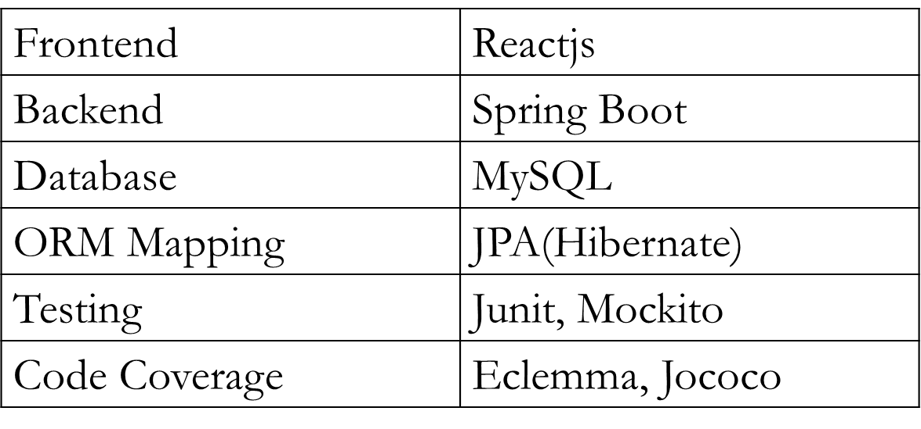





TECHNOLOGY STACK

Slide 5
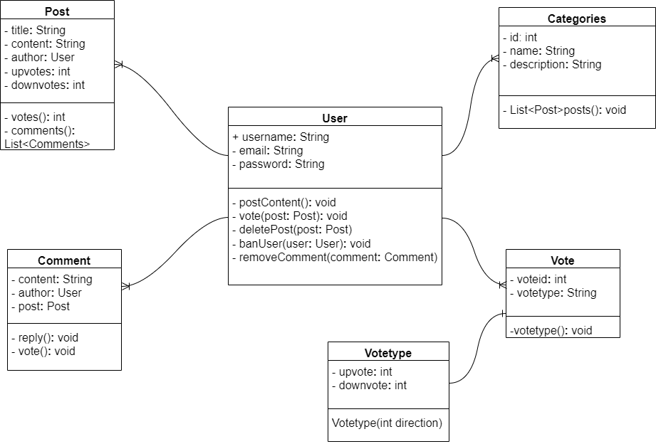
CLASS DIAGRAM

Slide 6
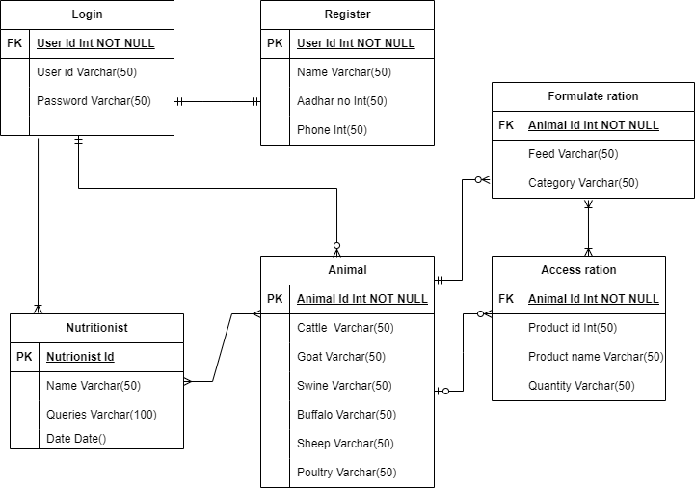
ENTITY-RELATIONSHIP DIAGRAM

Slide 7
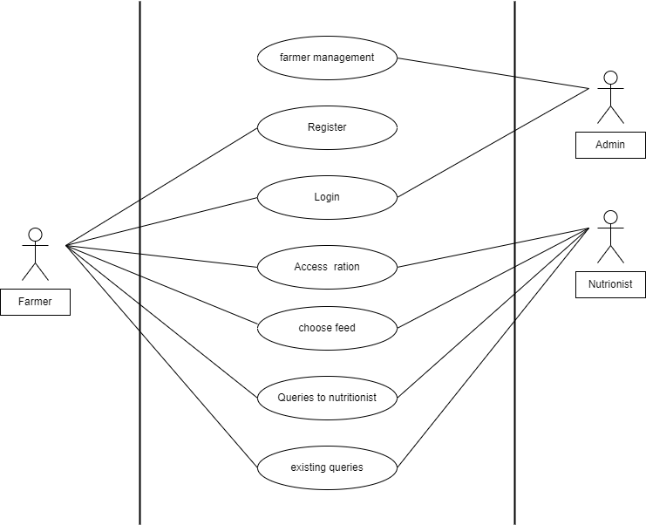
USE-CASE DIAGRAM

Slide 8
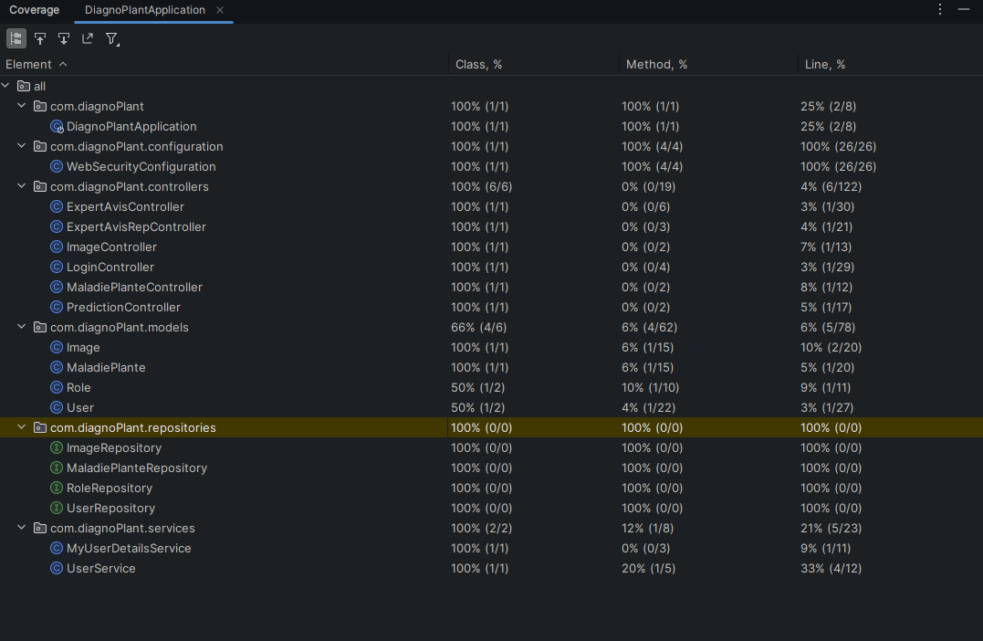
CODE COVERAGE

Slide 9

SCREENSHOTS

Slide 10


Slide 11
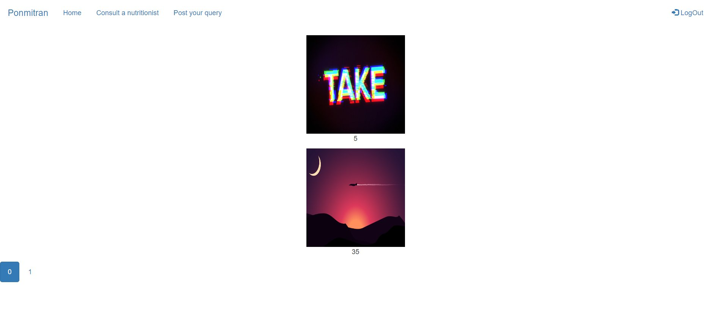

Slide 12
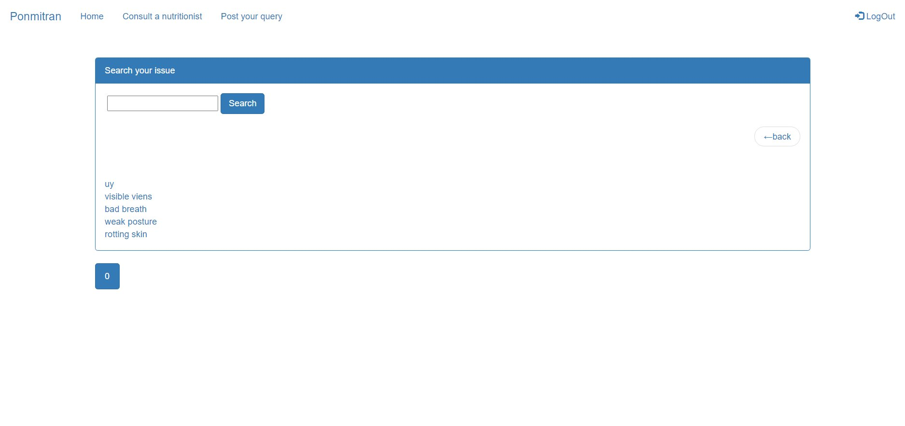
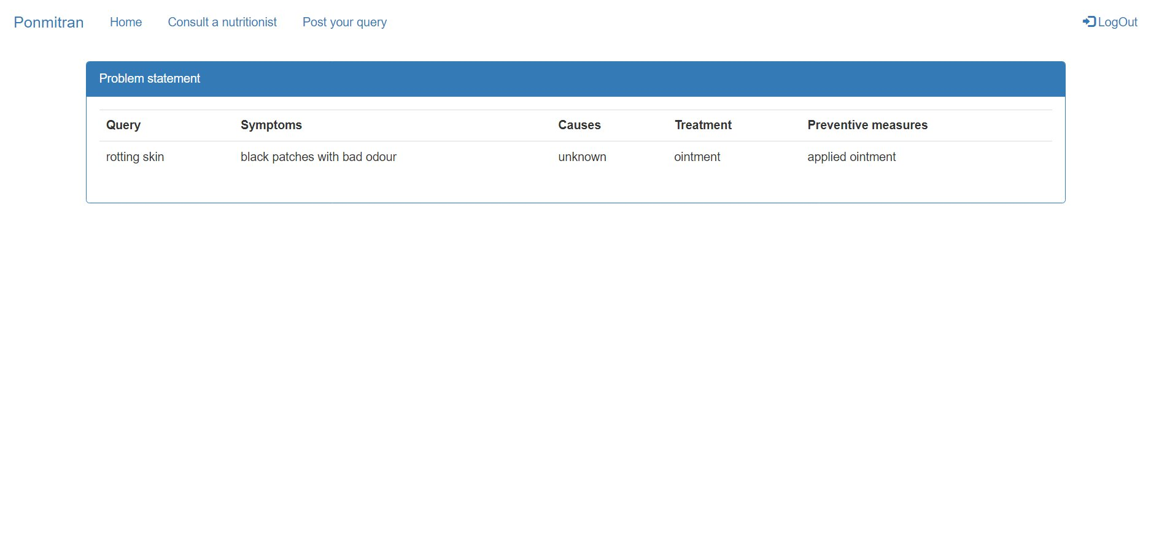

Slide 13
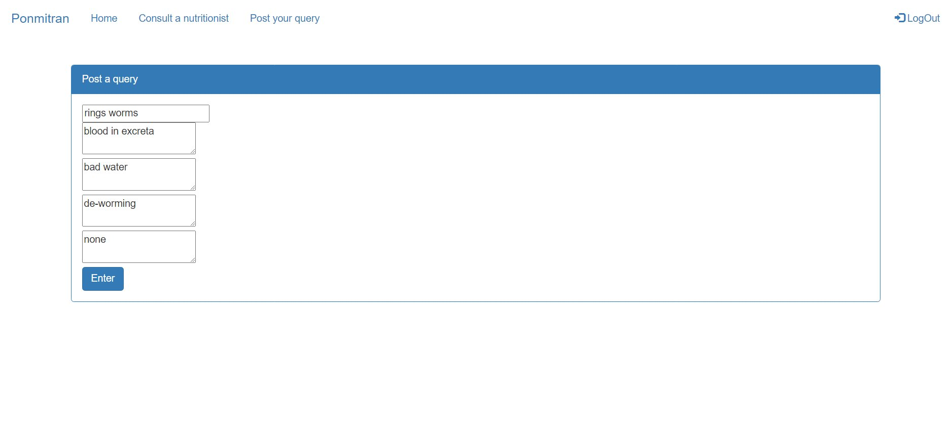
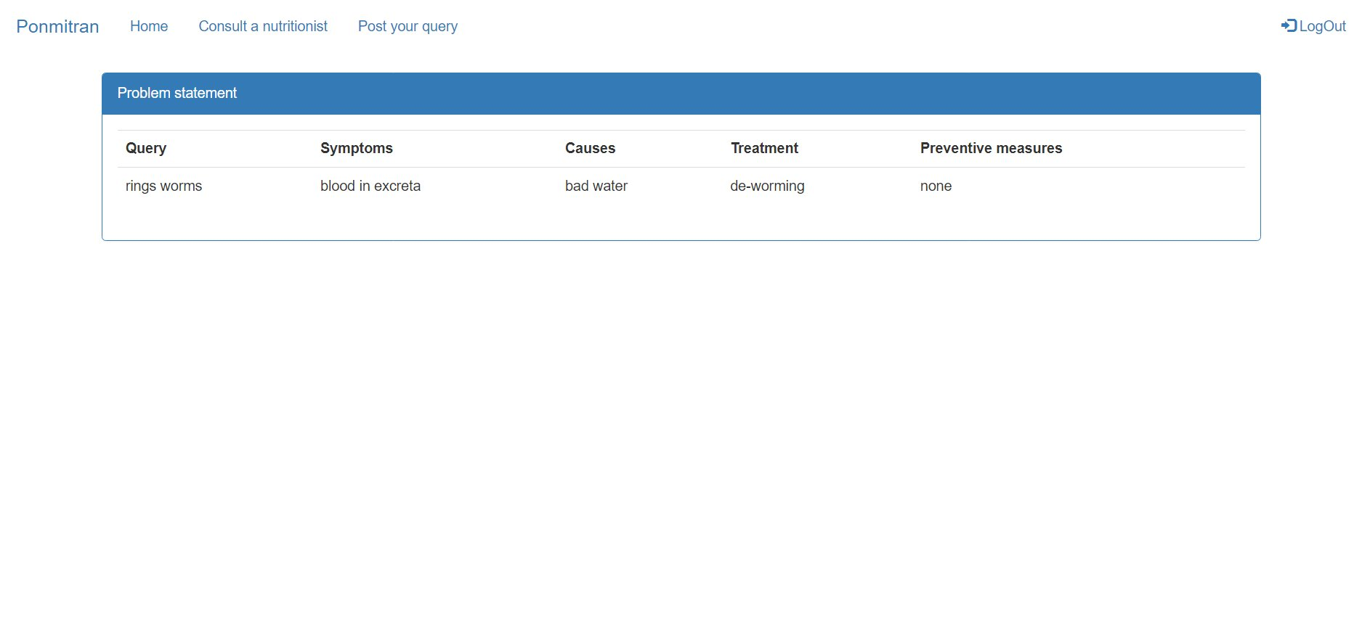

Slide 14
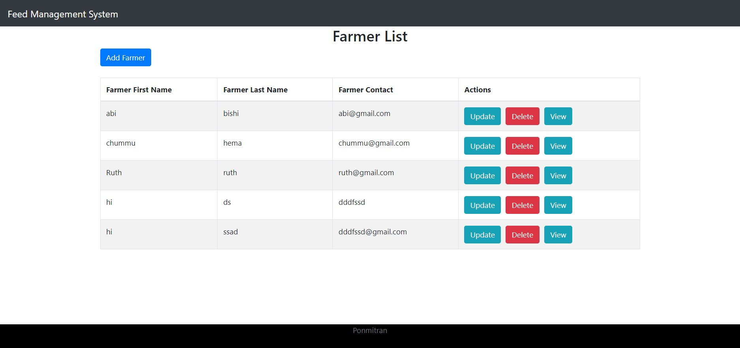
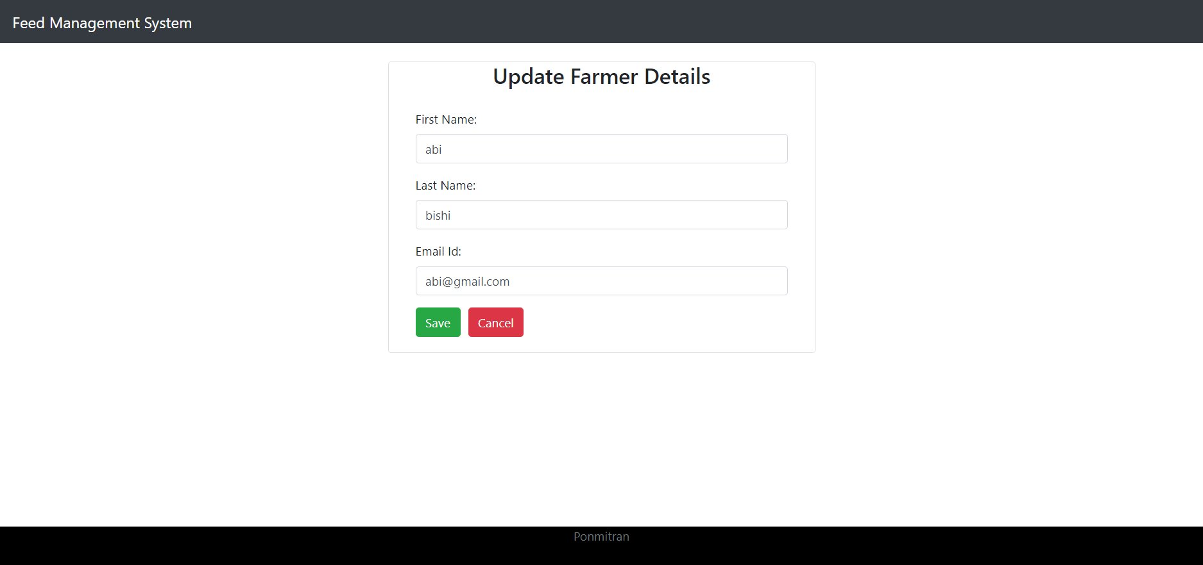

Slide 15
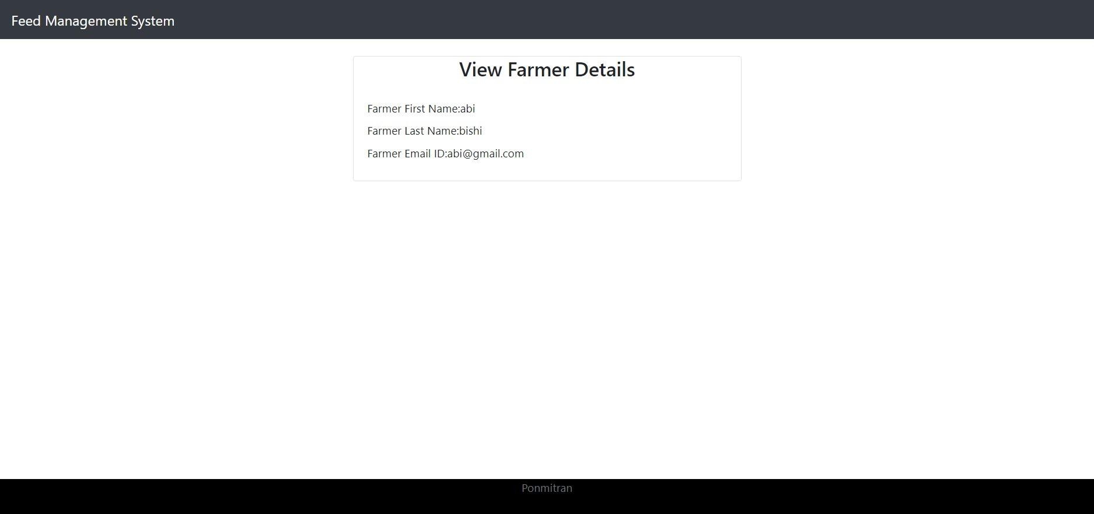
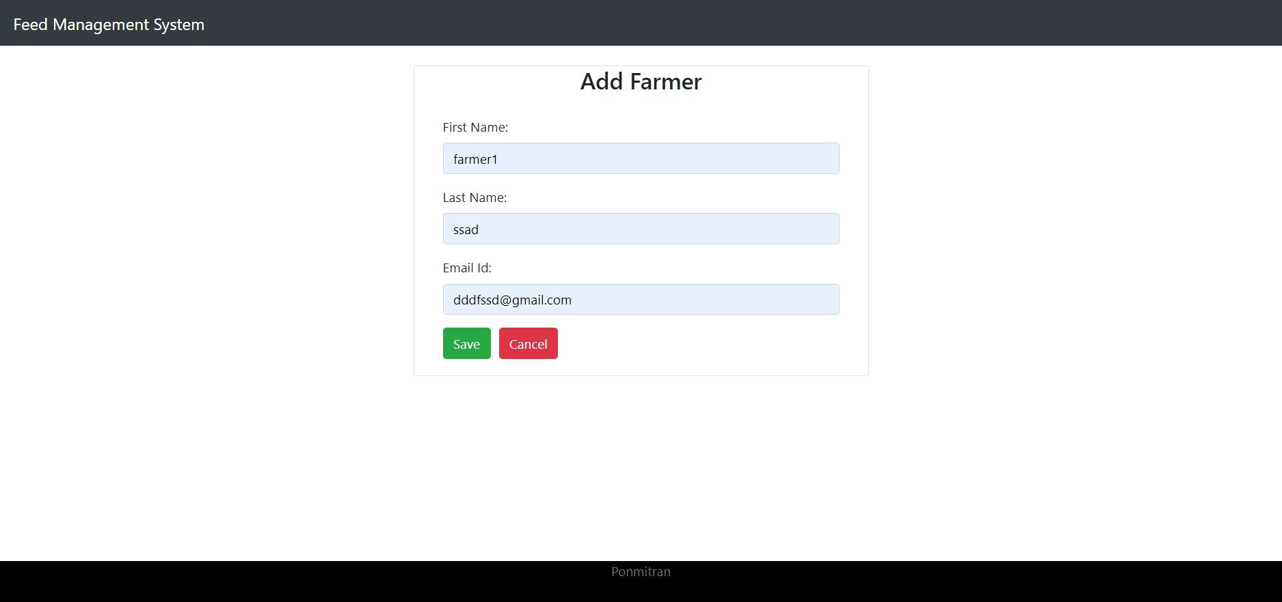

Slide 16
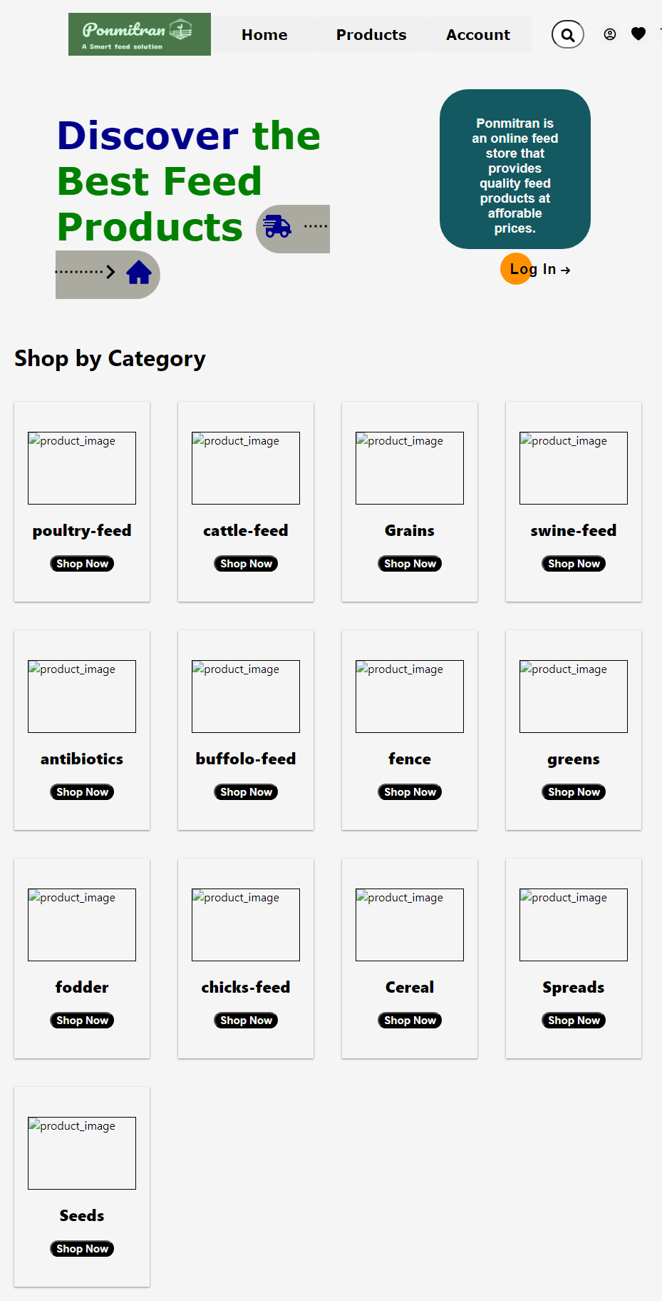

Slide 17
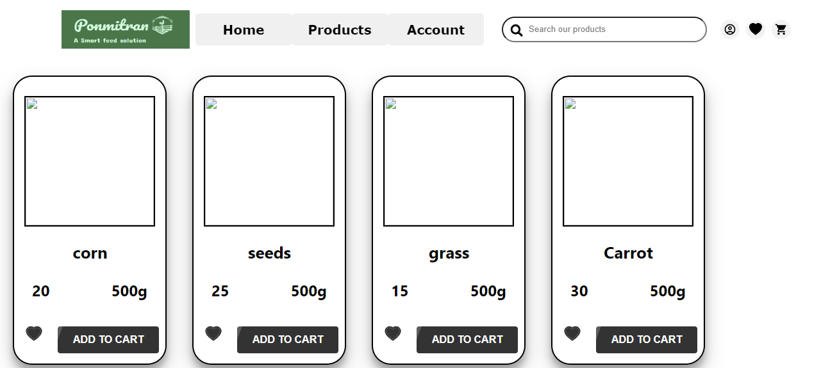

Slide 18
THANK YOU
DONE BY
MICHAEL ROBIN. K (20CS1073)
MANOGARI. S (20CS1071)

